Slide 1


Enterprise Azure Policy as Code (EPAC)

Slide 2




So, who am I?
My name is Luke Murray
He/Him
Senior Consultant in Hamilton, New Zealand.
Feel free to reach out on Social Media, if you need any help: https://linktr.ee/lukemurray
Introduction
Azure Cloud
Commanders

Slide 3
“Enterprise Azure Policy as Code or EPAC for short comprises a number of scripts which can be used in CI/CD based system or a semi-automated use to deploy Policies, Policy Sets, Assignments, Policy Exemptions and Role Assignments.”
Notes:
Enterprise Azure Policy as Code or EPAC for short comprises a number of scripts which can be used in CI/CD based system or a semi-automated use to deploy Policies, Policy Sets, Assignments, Policy Exemptions and Role Assignments.
Main features include:
Multi-tenant/environment policy deployment
Easy CI/CD Integration
Extract existing policy objects from an environment
Support JSON and CSV inputs for large complex policies
PowerShell Module
Integration with Azure Landing Zone recommended policies
Starter Kit with examples
Schema to provide Intellisense for VS Code development

Slide 4

What is Azure Policy?
KEEP
CALM
AND
MAKE IT SO IT IN AZURE
Notes:
Maintain regulatory compliance with industry standards
Security and performance consistencies
Enterprise-wide design principles
Controlling cost

Slide 5
METADATA
PARAMETERS
RULES
{
displayName: "Function apps should authenticate to Azure Container Registry using a managed identity",
metadata: {
version: "1.0.0",
category: "App Service"
},
mode: "Indexed",
parameters: {
effect: {
type: "String",
metadata: {
displayName: "Effect",
description: "DeployIfNotExists, AuditIfNotExists or Disabled the execution of the Policy"
},
allowedValues: [
"DeployIfNotExists",
"AuditIfNotExists",
"Disabled"
],
defaultValue: "DeployIfNotExists"
}
},
policyRule: {if: {
allOf: [
{
field: "type",
equals: "Microsoft.Web/sites"
},
{
field: "kind",
contains: "functionapp"
}
]
},
Policy Definition

Slide 6

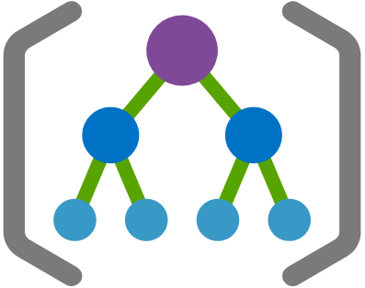

Policy Definition
Policy Definition
Policy Definition
Scope
Initiative
Assignment

Slide 7
Who should use Policy as Code?
KEEP
CALM
AND
MAKE IT SO IN AZURE
Notes:
EPAC is designed for organizations with a large number of Policies, Policy Sets and Assignments. It is also designed for organizations with multiple tenants and/or environments.
You can also combine ALZ and EPAC through the provided "Integration of EPAC with Azure Landing Zones".
EPAC can be used by small organizations with a small number of Policies, Policy Sets and Assignments. Depending on their DevSecOps maturity, Azure Landing Zones direct implementation of Policies might be a better choice.
For extremely small Azure customers with one or two subscriptions Microsoft Defender for Cloud automated Policy Assignments for built-in Policies is sufficient.

Slide 8
It is in Preview!
Notes:
Disclaimer: Public Preview as of Jan 2024, responses and capabilities can change daily. What you see today, may not necessary match what you get when it goes GA.
Pricing hasn’t been announced, this functionality is free during Public preview., whether it remains free is still to be confirmed

Slide 9
Ten questions per convo (5 convo per day per user)
Some responses that use lists, limited to top 5
Microsoft Copilot for Azure
Some tasks, resource name won’t work, Resource ID required
Limitations
Available in English only
Cost management scope at Subscription
Limited number of skills

Slide 10
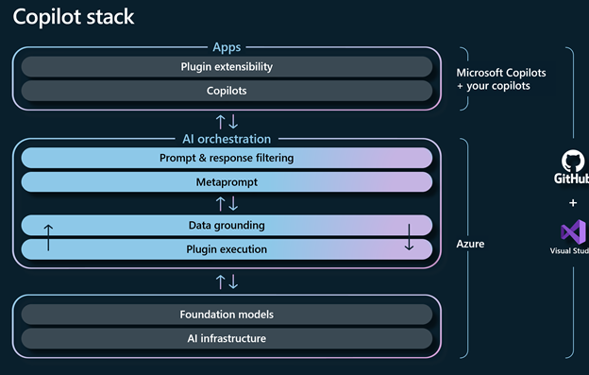
Azure Copilot portal
Copilot Stack
Prompt and context
RAG
(Retrieval augmented generation)
Meta prompt and response
Notes:
Portal – Azure Bot framework
RAG (Microsoft Learn Documentation, Azure Resource Graph, Cost Management, Skills, Guardrails (i.e. Azure Policy, RBAC, Budgets)
Microsoft Copilot for Azure only has access to resources that you have access to and can only perform actions that you have the permissions to perform, after your confirmation. Microsoft Copilot for Azure will respect all existing access management and protections such as Azure Role-Based Action Control, Privileged Identity Management, Azure Policy, and resource locks.
Ground together
(GPT 4)

Slide 11



Design
Configure and create the right services
Operate
Answer questions, author complex commands, and manage resources
Troubleshoot
Orchestrate across Azure services for insights to summarize issues, identity cussed and suggest solutions
Optimize
Improve costs, scalability, and reliability through recommendations for your environment
Teams
Business
Microsoft Copilot for Azure
Platforms

Slide 12

KEEP
CALM
AND
COPILOT IT IN AZURE
Design
Notes:
Be curious:
General: I want to setup a new web application for internet shopping, what infrastructure should I use?
Intermediate: When setting up a new web service, that allows people to purchase my products using Azure services, what infrastructure should I use?
Intermediate: List all suggested Azure services for my internet shopping service and how they could connect together, including considerations?
Intermediate: Create these services
# Operation not currently supported.
Advanced: Are there any services I am missing? Also list all the suggested services in a table, including a column on what each service could be used for when looking at my internet shopping application
Advanced: What is the recommended requirements that I need to gather, to create my scalable and secure internet shopping application? List requirements, as a list
Advanced: Give me examples of security requirement questions?’

Slide 13
KEEP
CALM
AND
COPILOT IT IN AZURE
Operate
Notes:
General: List all resources and their regions
5 – remember list limitation
Create a table of all resources and their region?
Same issue.
Give me a list of the top resource types?
List all virtual machines and their power state?
Shutdown all virtual machines currently running
Start all virtual machines currently stopped
Can you help me reset the password of VM1?

Slide 14
KEEP
CALM
AND
COPILOT IT IN AZURE
Optimize
Notes:
List all recommendations from Azure advisor?
Show me the highest resource cost for the past 12 months?
# Select scope trey platform – unable to support management group scopes.
How can I optimize my environment?
create a naming convention for SQL databases
How can I protect my storage accounts
Show me all resources that are noncompliant

Slide 15
KEEP
CALM
AND
COPILOT IT IN AZURE
Troubleshoot
Notes:
How can I troubleshoot not being able to rdp to VM-1
Check 3389 is open on VM-1
What are the security implications of opening port 3389?
Create PowerShell script to test 3389 is opened on VM-1
adjust the script to use its public IP instead
Take me to VM-1
What is the public IP of VM-1
What is this resource?
What are the open alerts?
Am I impacted by any service health events?

Slide 16
KEEP
CALM
AND
COPILOT IT IN AZURE
Other
Notes:
Change theme to light or dark
Infrastructure as code – reader.

Slide 17
Get Resource Info
Build Virtual Machines
Deploy Infrastructure
Get monitoring info
Optimize your code
Azure Stack HCI
Secure and protect storage accounts
Troubleshoot WebApps
Author API Management Policies
Generate Kubernetes YAML files
Understand service health
Analyze costs
Tasks
Skills
Notes:
Enhanced scenarios or skills

Slide 18
Conclusion
Notes:
As a beginner user to Azure, I feel that Microsoft Copilot for Azure, can help point you in the right directions, and to the right information.
Context is key – the service, takes context on what resource you are at in the Azure Portal, so the more context it has on the resource the better outputs you will get.
As with all generative AI services, clear prompts are key, and don’t trust the outputs, not all Graph queries are right.
In terms of more intermediate and advanced services, it won’t replace full on azure management capabilities and troubleshooting yet, remember this is a copilot, an assistant.
The more feedback can be offered, as part of its use – the better it would be, and more skills and tasks it will be able to complete.

Slide 19

THANK YOU!

